Slide 1


8. CNN, RNN
Ha-rang-Kim
24.3.2
ⓒSaebyeol Yu. Saebyeol’s PowerPoint

Slide 2
Table of contents
1
Convolutional Neural Network
2
Recurrent Neural Network

Slide 3
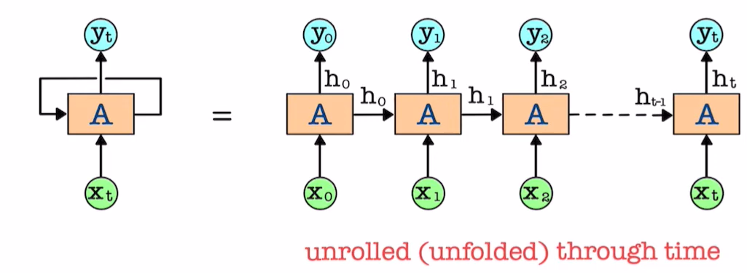
RNN
<LSTM(long short term memory)>
Make predictions based on Current and previous inputs recurrently
Doesn’t require fixed sized time window -> handle variable length sequence
Xt : current data, ht : hidden state vector (memory for past information)
-learn to selectively retain relevant information to Capture temporal dependency or structure across multiple time step

Slide 4
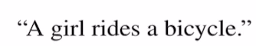
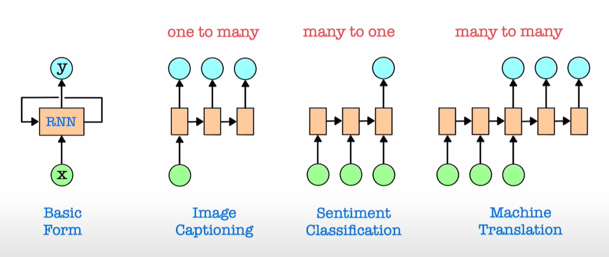
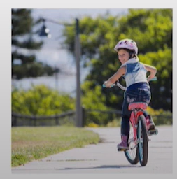
RNN

Slide 5
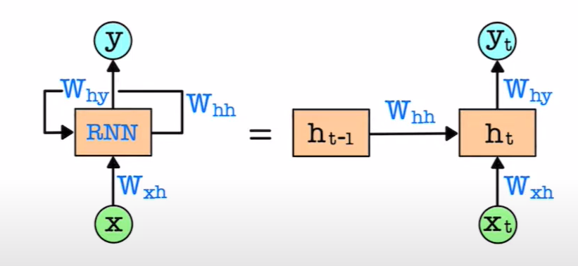
RNN
<Simple RNN>
Each time step t - Input: Xt, Output: yt, Prior hidden state: ht-1, Current hidden state: ht

Slide 6
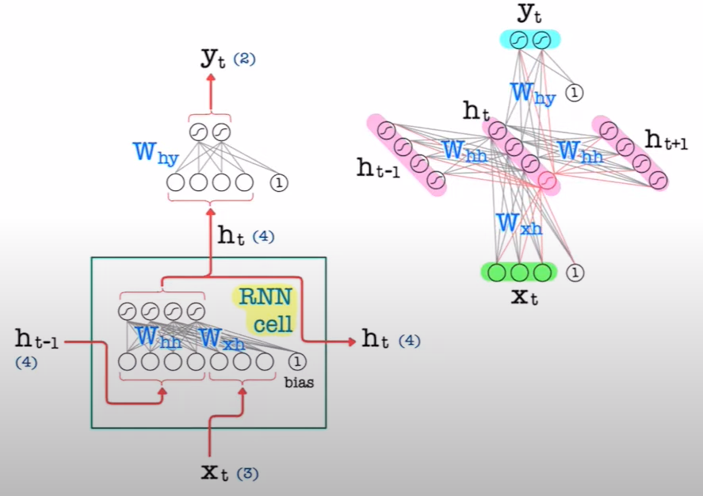
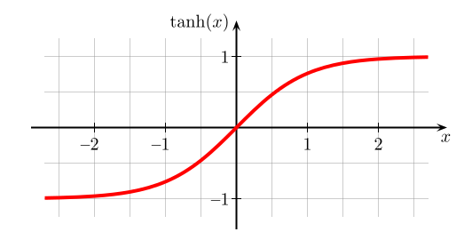
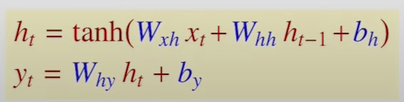
RNN
<Simple RNN>
-1~1
dimension of ht vector - hyperparameter

Slide 7
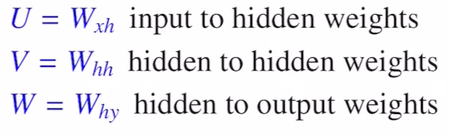
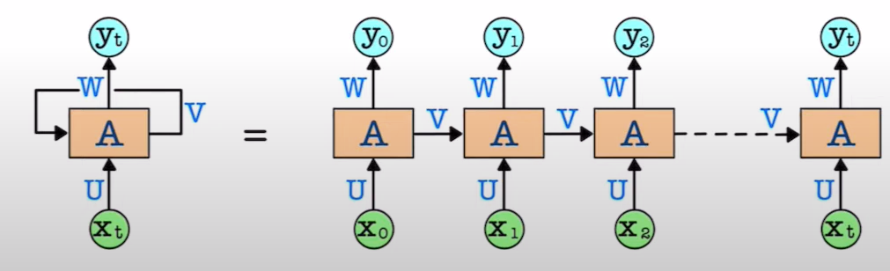



RNN
<BPTT (BP Through Time)>
DNN – Uses BP to update weights in the way to minimize cost
RNN – Uses a variation of BP called BPTT to control temporal dependencies

Slide 8
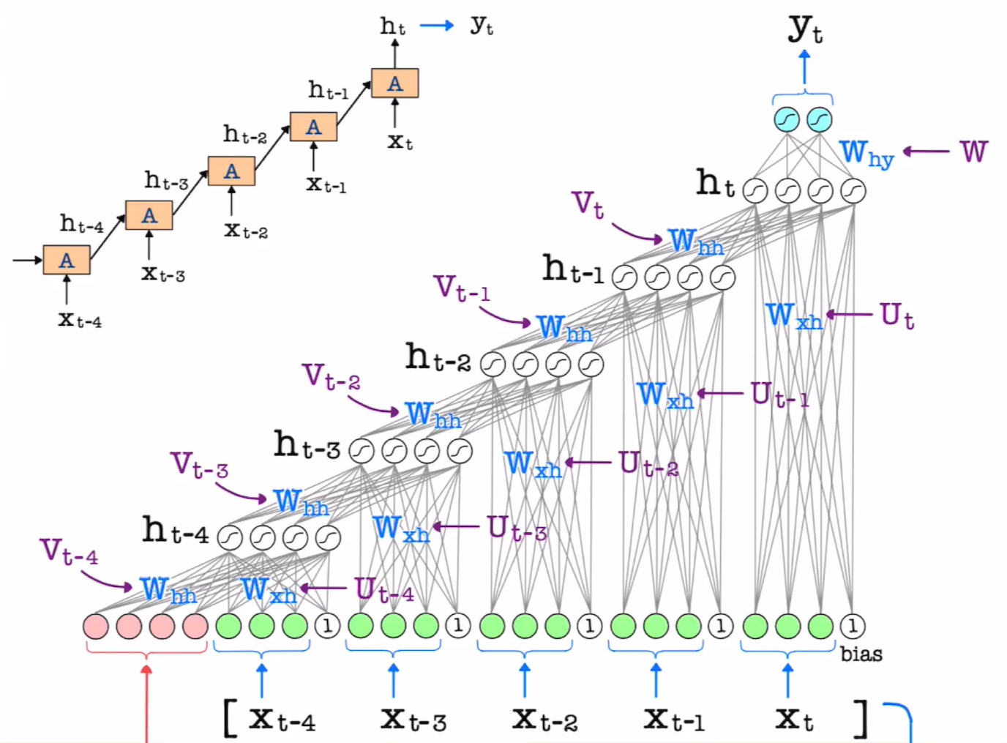






















RNN
<BPTT (BP Through Time)>
The same weight values are used,
but the gradient values are different

Slide 9
RNN
<BPTT (BP Through Time)>
Standard BP -> compute the gradient with respect to all weight
Final gradient of U and V = average (or sum) of all gradients of Ui’s and Vi’s respectively, and applied to RNN weight updates.

Slide 10
RNN
<Truncated BPTT>
BPTT
Long sequential data -> slow training (RNN)
Accumulation of gradients over many time step can result in a shrinking of value to zero, or a growth of value that eventually overflow
Truncated BPTT
Limits the number of timesteps on BP and estimate the gradient used to update the weights rather than calculate it fully
Hyperparameter: number of timesteps (lookback) -> split up into subsequence (that are both long enough to capture relevant past information for making predictions and short enough to train efficiently)
X1, X2, X3, X4, X5, X6, X7, X8, X9

Slide 11
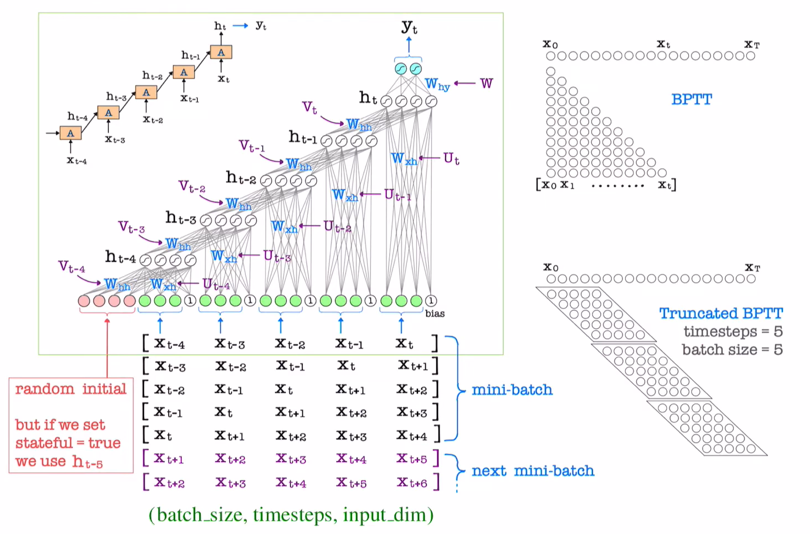
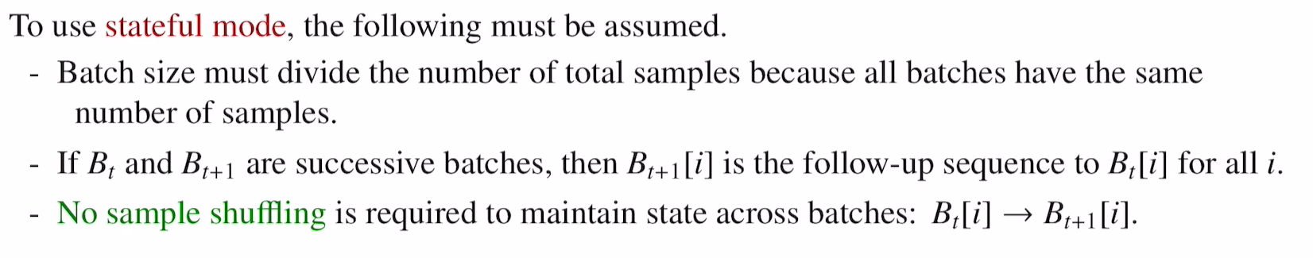





RNN
<TBPTT (Truncated BP Through Time)>
RNN input data : 3D tensor with shape
(batch_size, timestepes, input_dim)
ht
input
Shuffle (in mini_batch)
25 gradient -> sum-> update

Slide 12









RNN
<TBPTT (Truncated BP Through Time)>
Keras provides 2 ways of maintaining RNN hidden states (and additional cell states in LSTM)
Default mode: states are only maintained over each individual sample for lookback number of time steps starting with a random initial state.
Stateful mode: states are maintained along successive batches so that the final state of ith sample of the current batch is used as initial state for ith sample of the next batch.

Slide 13
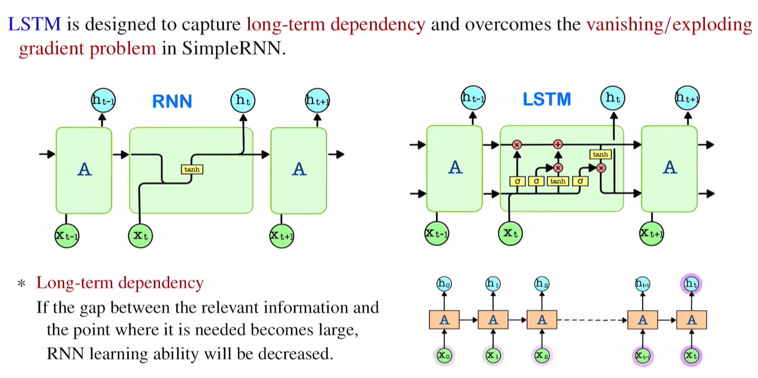
RNN
<LSTM (Long Short-Term Memory)>
Long-term memory
Shor-term memory

Slide 14
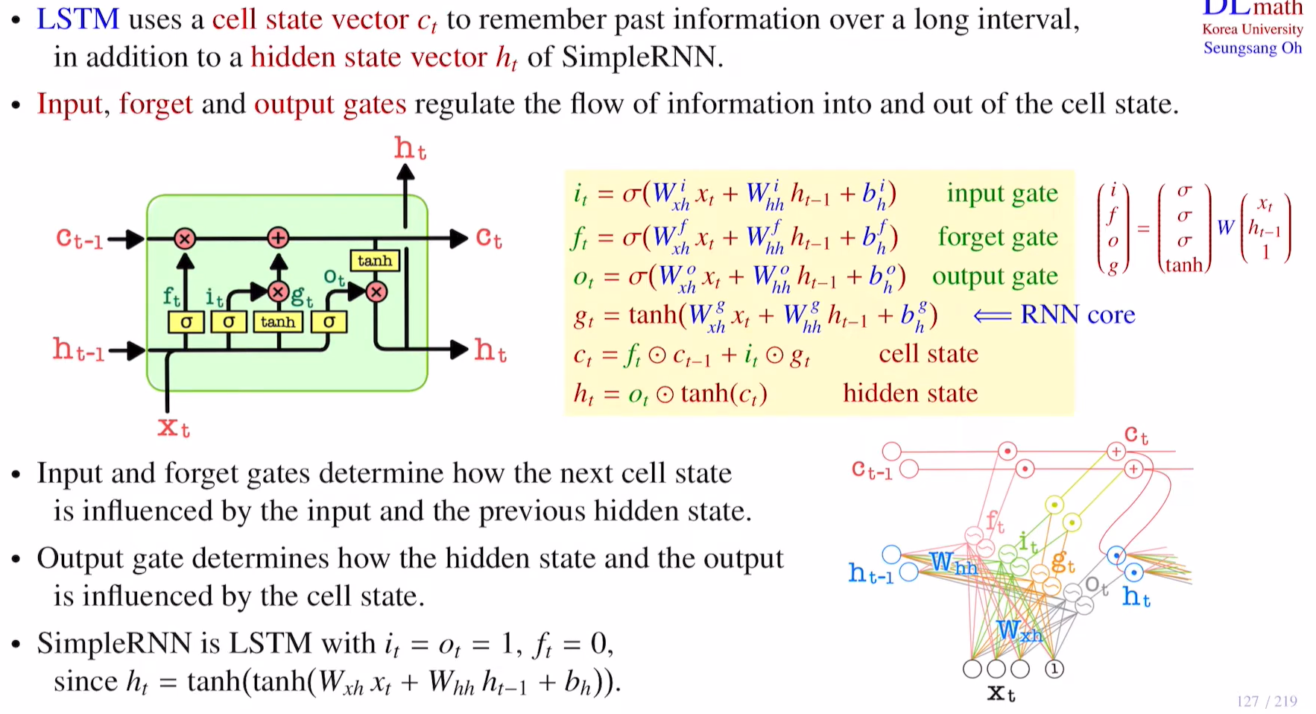




RNN
<LSTM (Long Short-Term Memory)>

Slide 15

RNN
<LSTM (Long Short-Term Memory)>

Slide 16
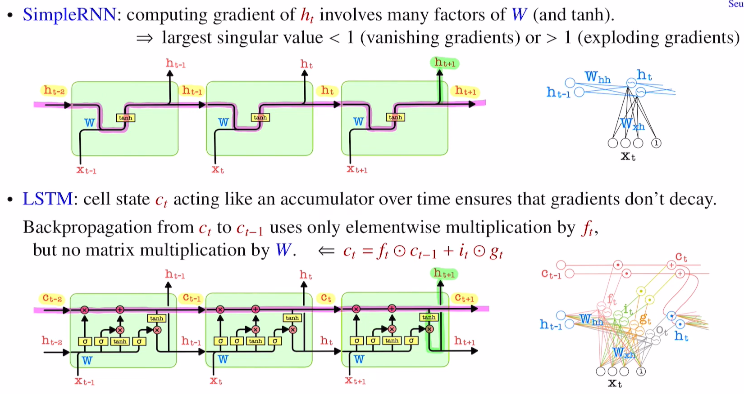
RNN
<LSTM (Long Short-Term Memory)>

Slide 17
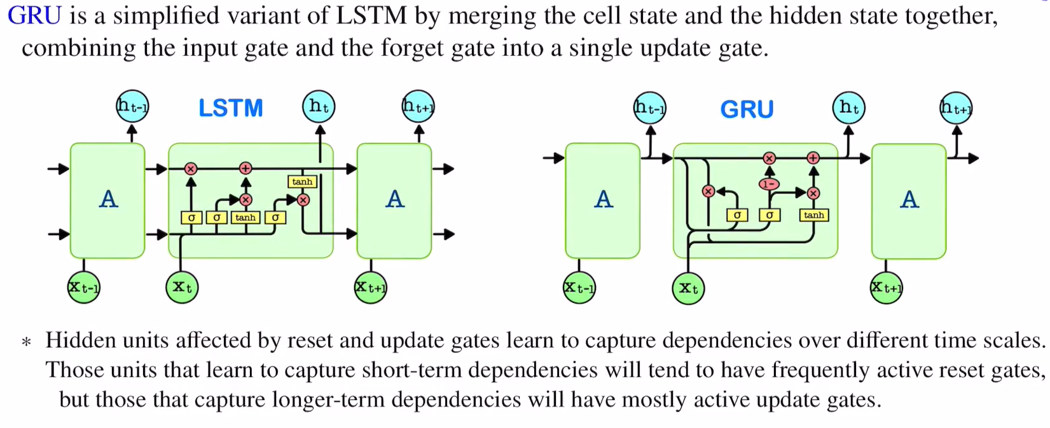








RNN
Cell state
Hidden state
Merge
<GRU (Gated Recurrent Unit)>
Forget gate
Input gate
Update gatev
Output gate -> reset gate
ouput gate X -> reset gate

Slide 18
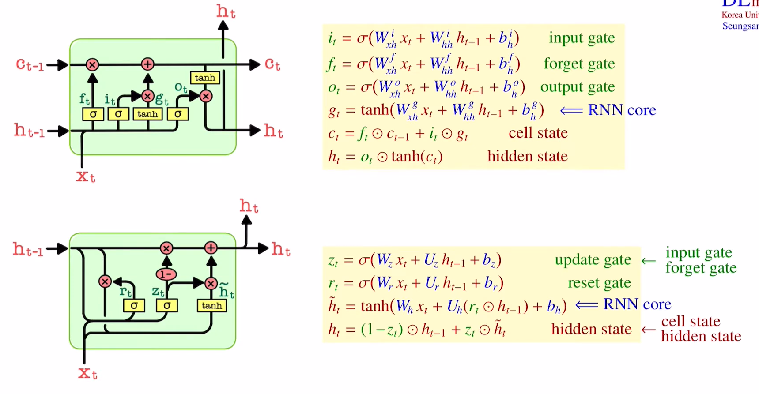


RNN
<GRU (Gated Recurrent Unit)>
Wxh Whh
$If zt, rt = 1, h_{t}={\tilde{h}}_{t}=tanh⁡(W_{h}x_{t}$+$U_{h}h_{t−1}+b_{h})$

Slide 19






RNN
<GRU (Gated Recurrent Unit)>

Slide 20
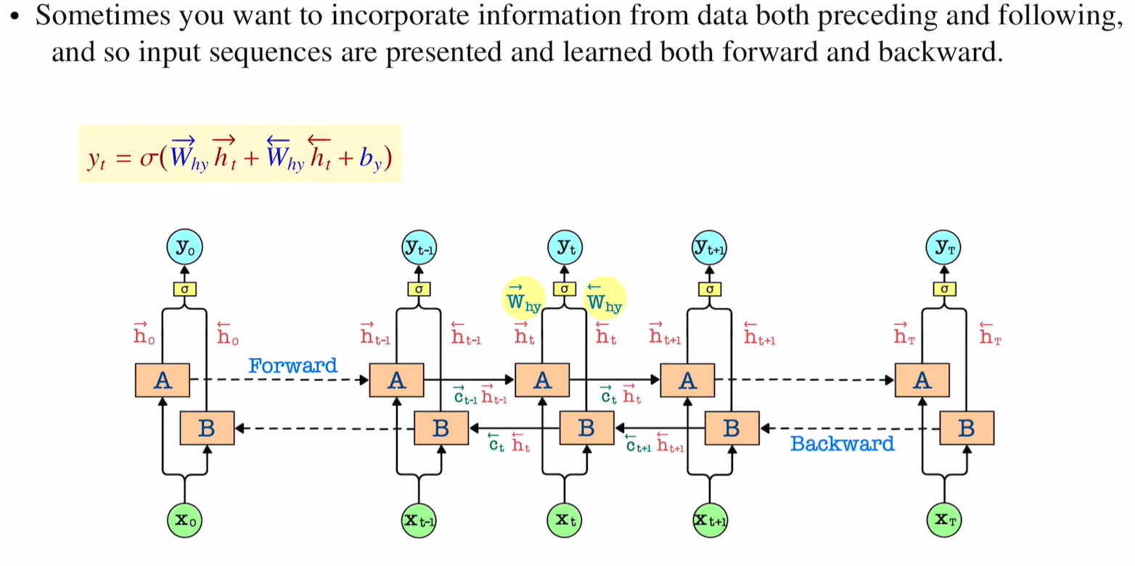
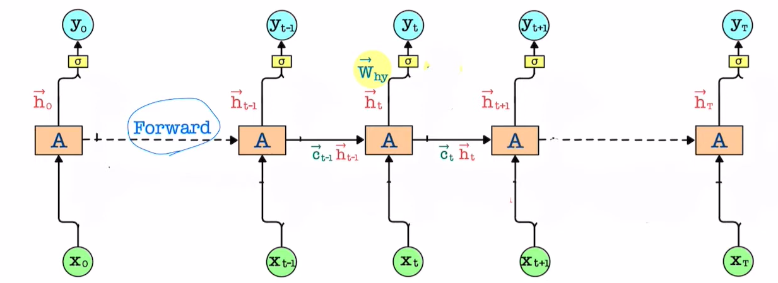






RNN
<Bidirectional LSTM (understanding context)>

Slide 21
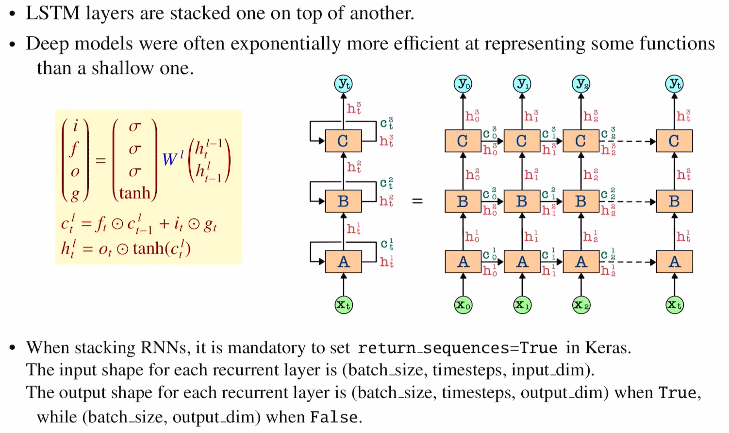





RNN
<Stacked LSTM>

Slide 22
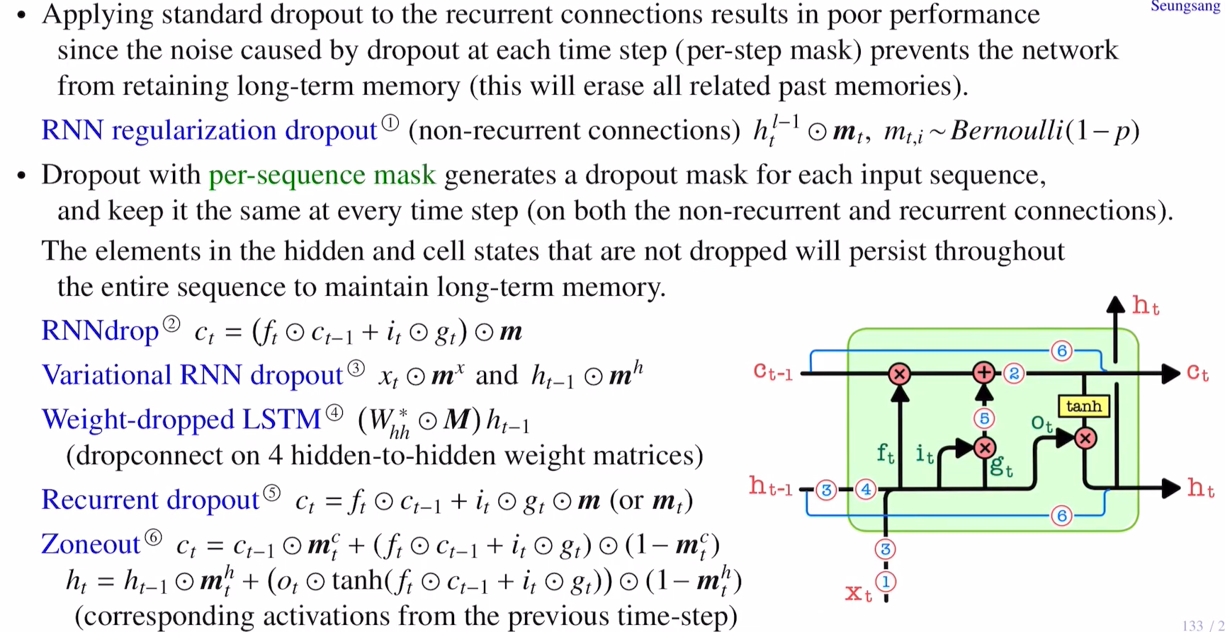
RNN
<Drop out in LSTM>

Slide 23
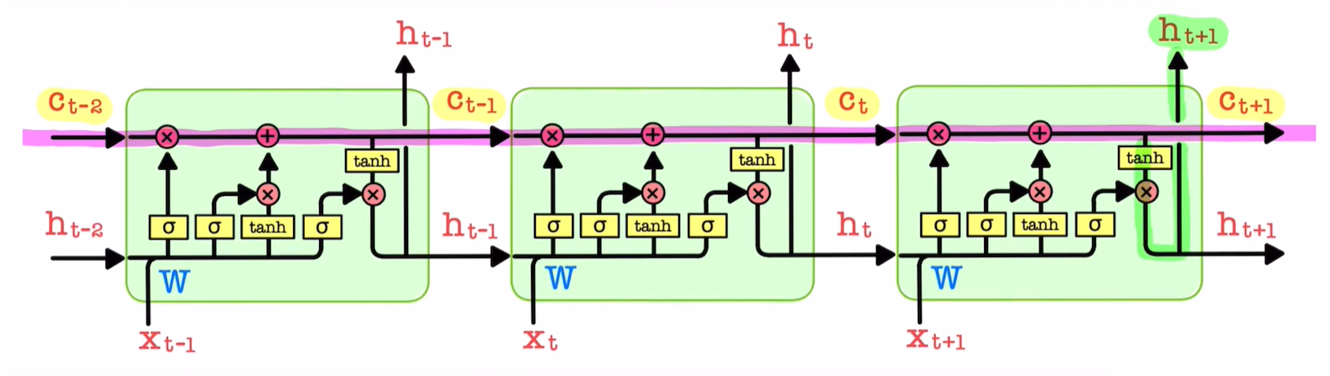
RNN
<Drop out in LSTM>
Unfolded LSTM

Slide 24

RNN
<Drop out in LSTM>
Stacked LSTM

Slide 25
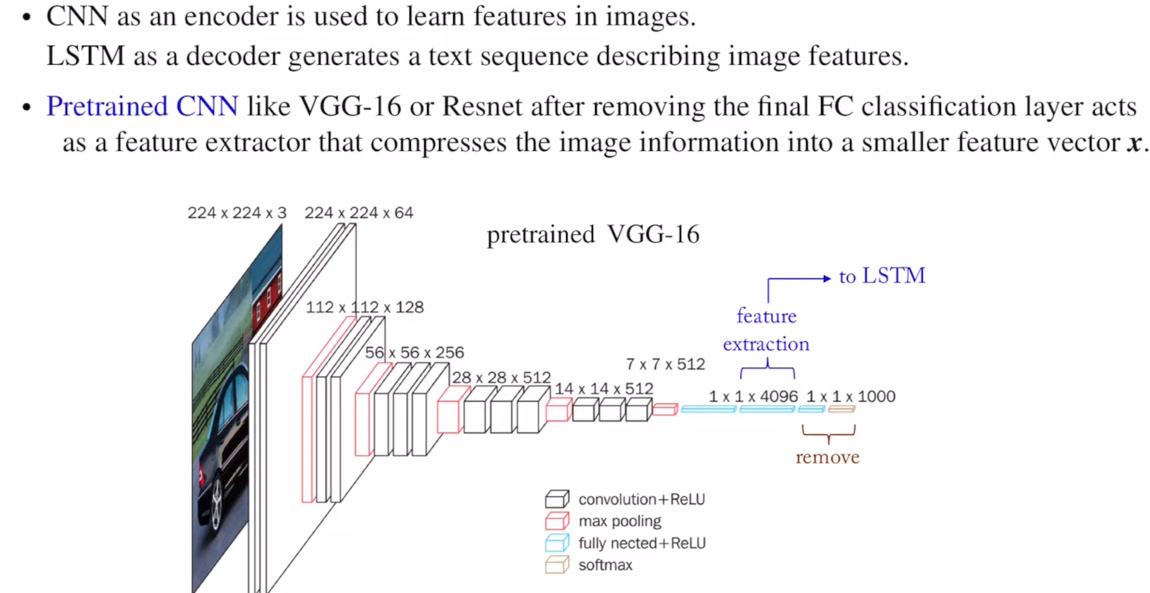


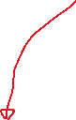

RNN
<Visual attention>
CNN-LSTM model for Image Captioning

Slide 26
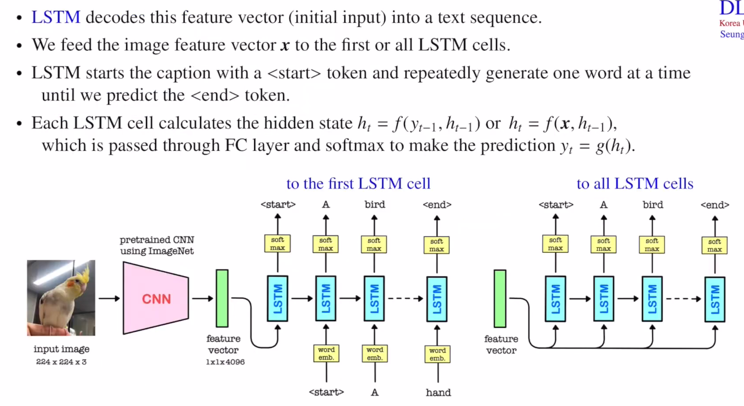

RNN
<Visual attention>
CNN-LSTM model for Image Captioning

Slide 27
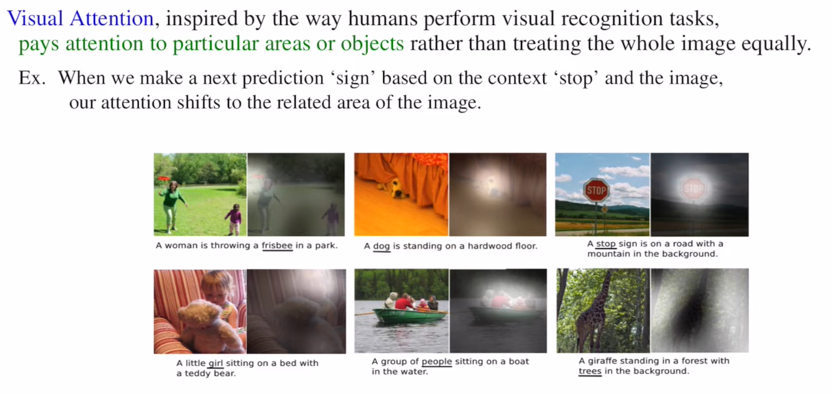

RNN
<Visual attention>

Slide 28
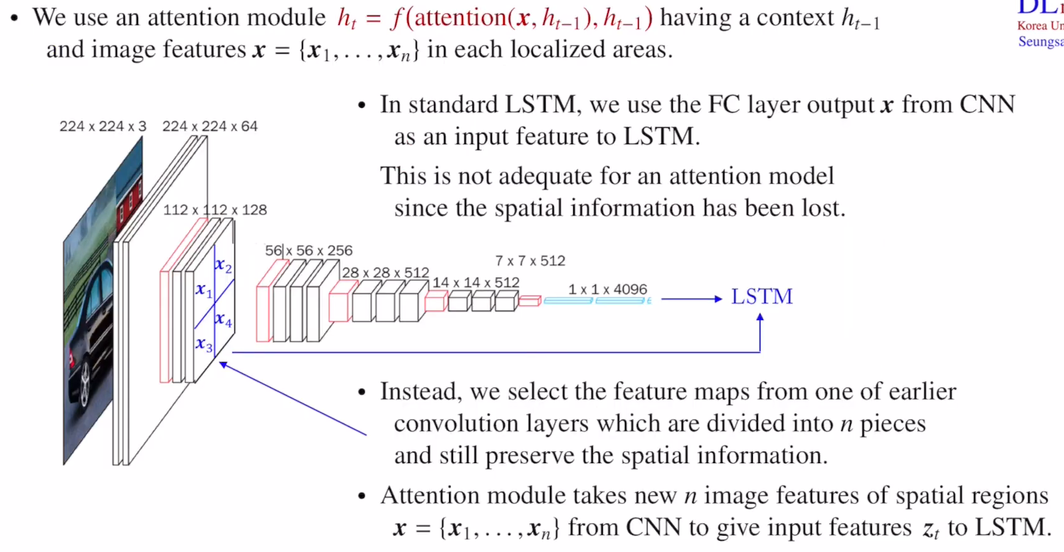






RNN
<Visual attention>
$h_{t}=$ f(x,${ h}_{t−1})$

Slide 29
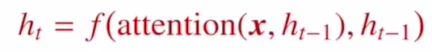
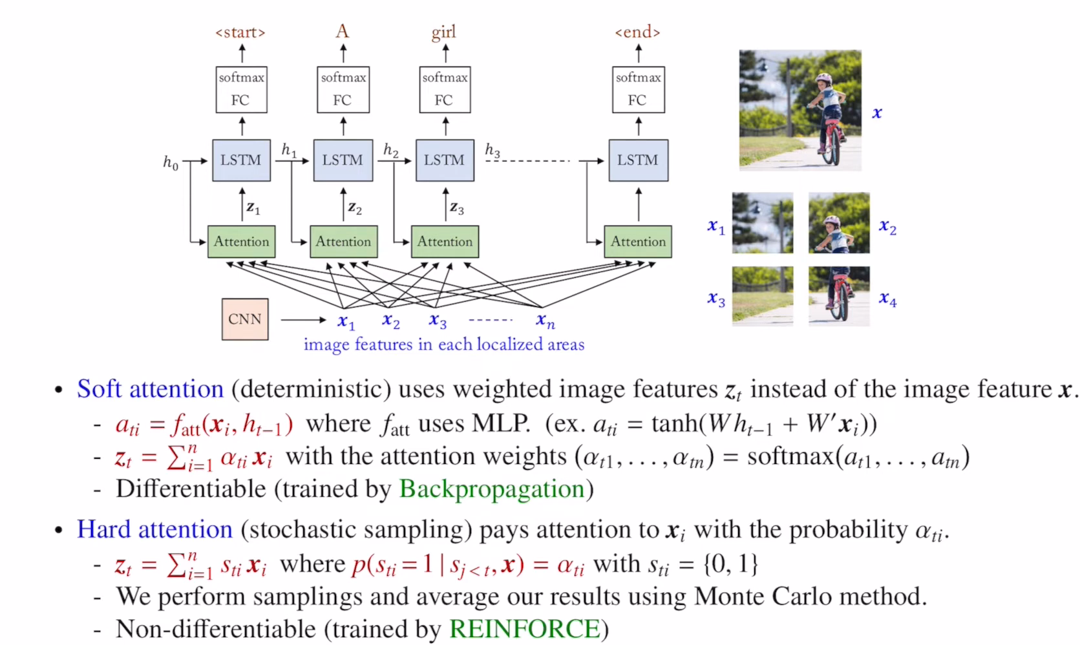




RNN
<Visual attention>

Slide 30
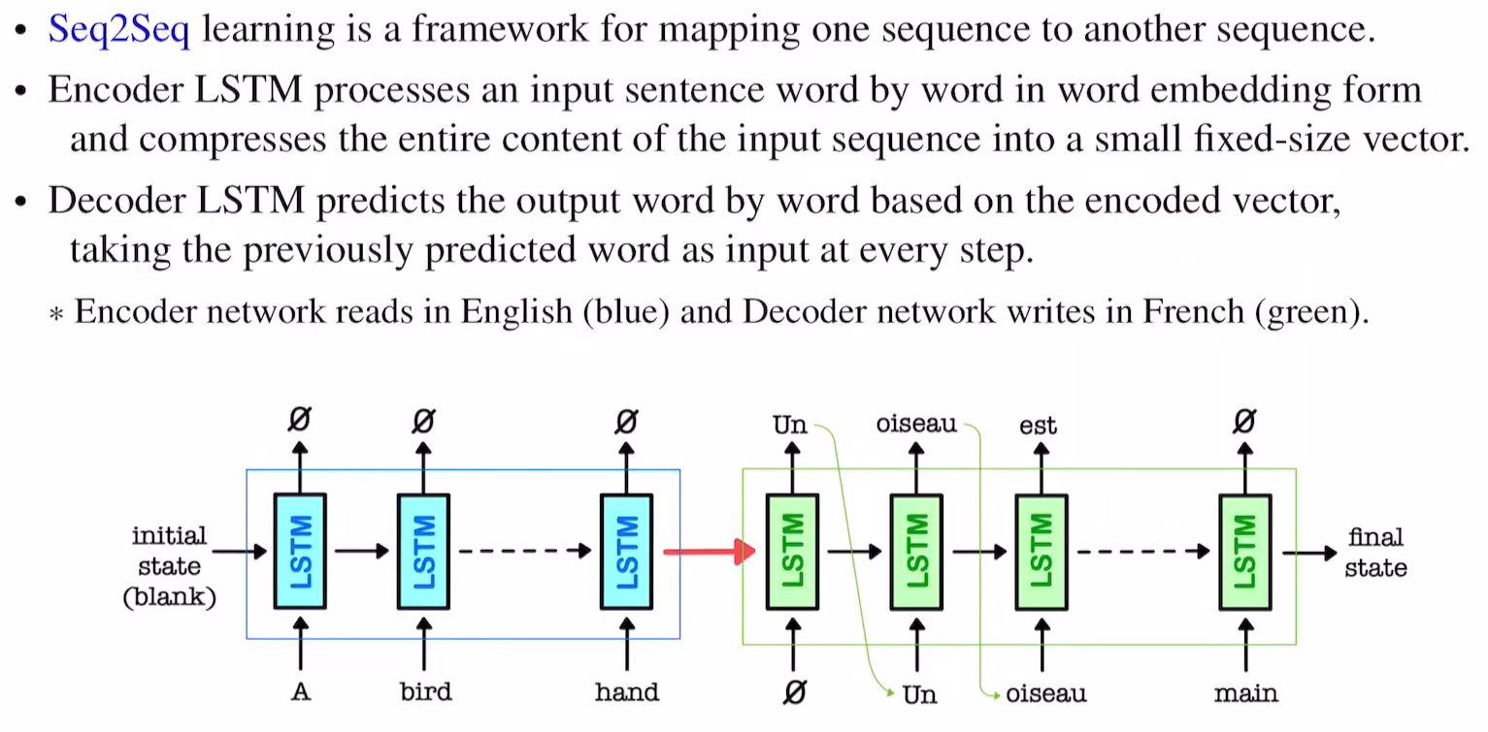
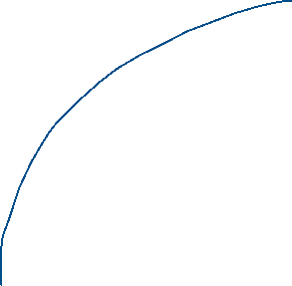






RNN
<attention mechanism>
Seq2seq for Machine Translation
Vector ( , , ,)

Slide 31
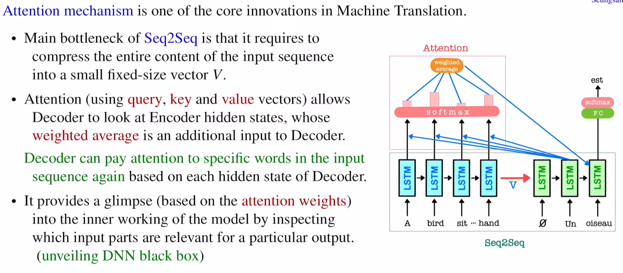



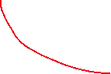



RNN
<attention mechanism>
Attention LSTM

Slide 32
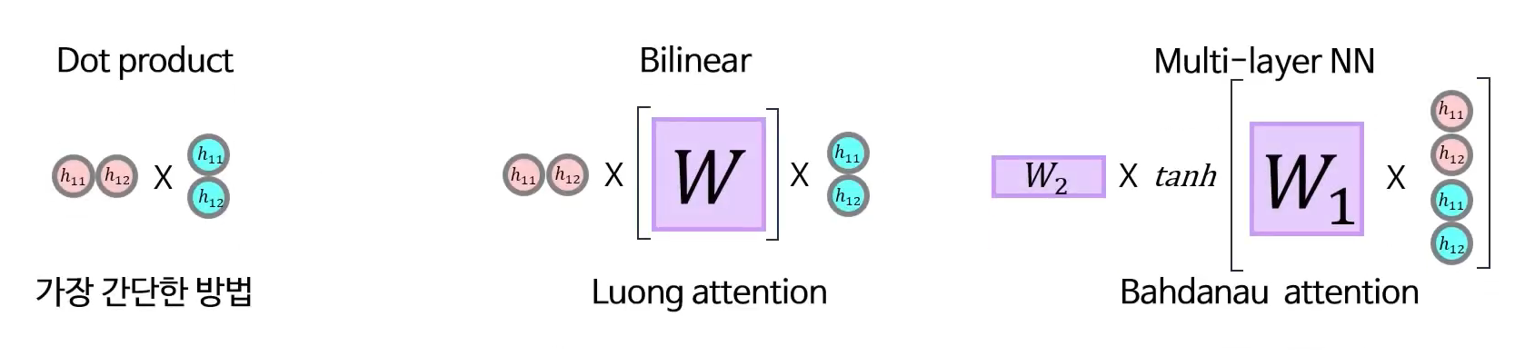
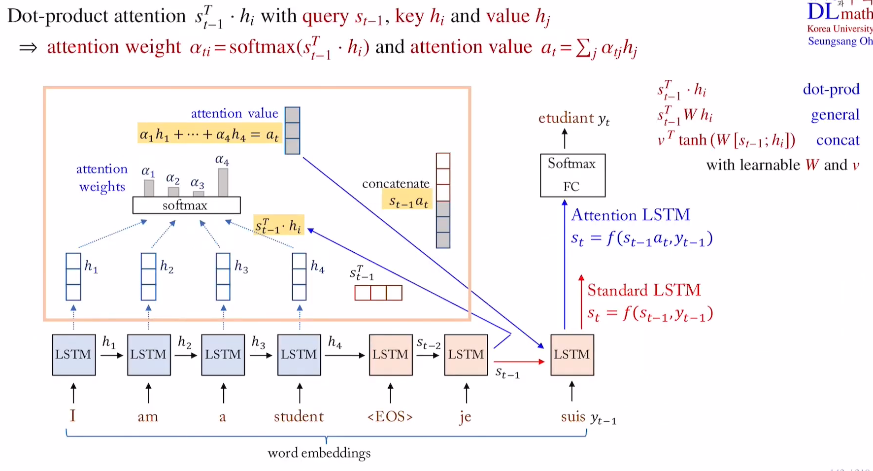















RNN
<attention mechanism>
Attention LSTM

Slide 33
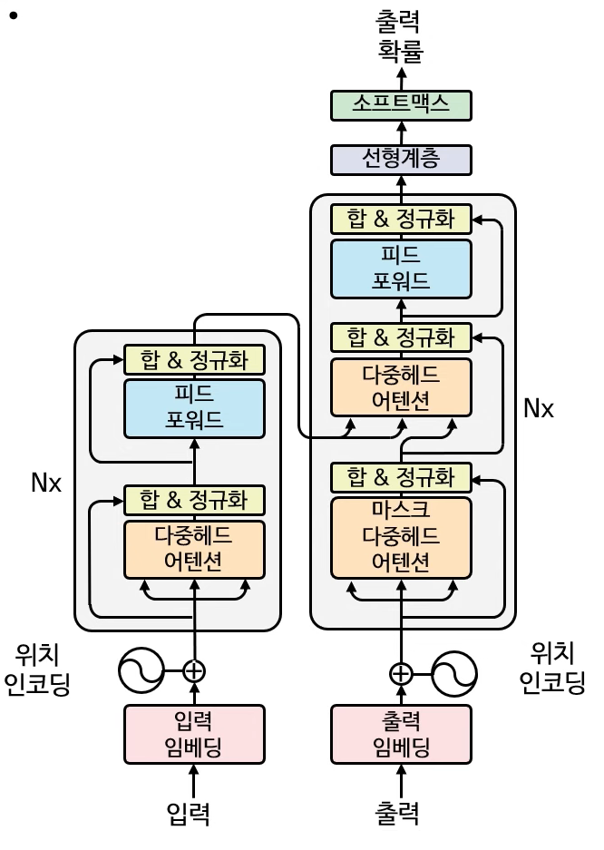





RNN
<attention mechanism> - Transformer

Slide 34
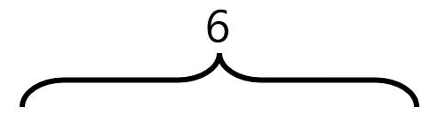
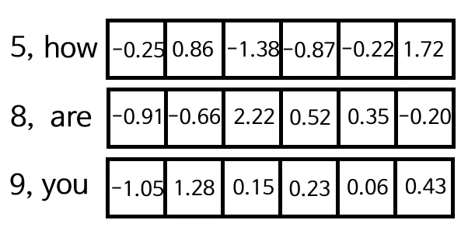
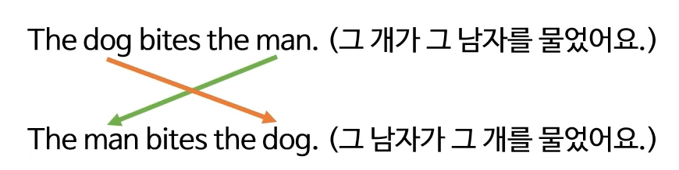
RNN
<attention mechanism> - Transformer
Input embedding
37000 word -> 512 dimension (In 2017)
Word
Embedding
Vector
<=
+
Position

Slide 35
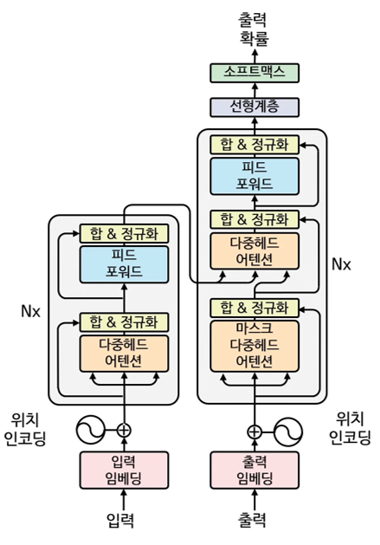
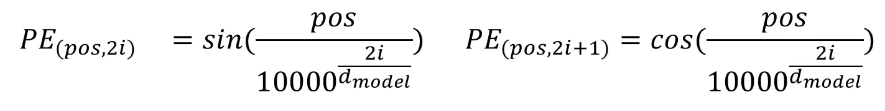
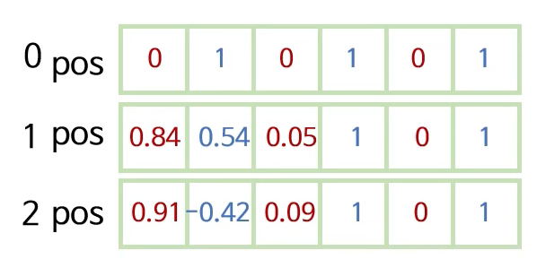
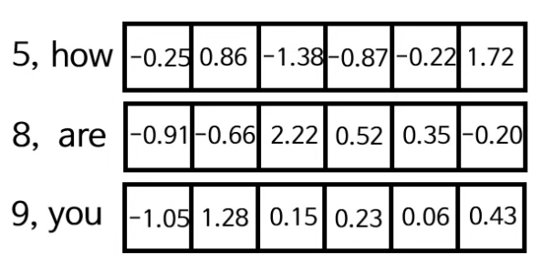
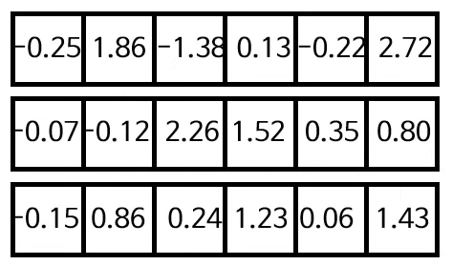

RNN
<attention mechanism> - Transformer
Input embedding
Positional encoding
+

Slide 36
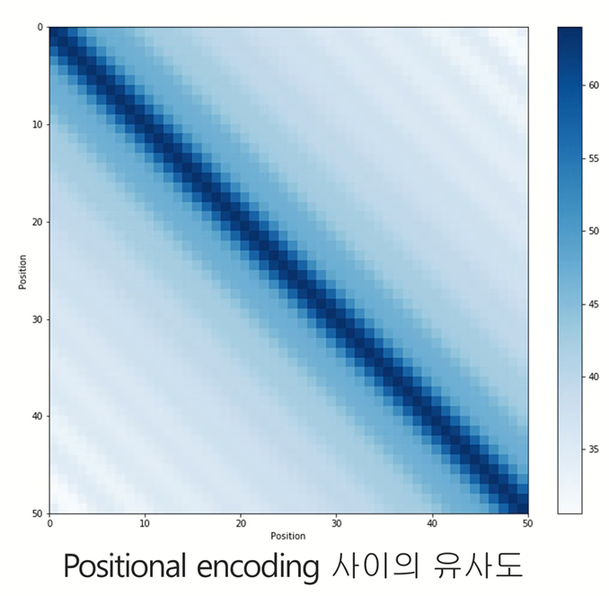
RNN
<attention mechanism> - Transformer
Input embedding

Slide 37
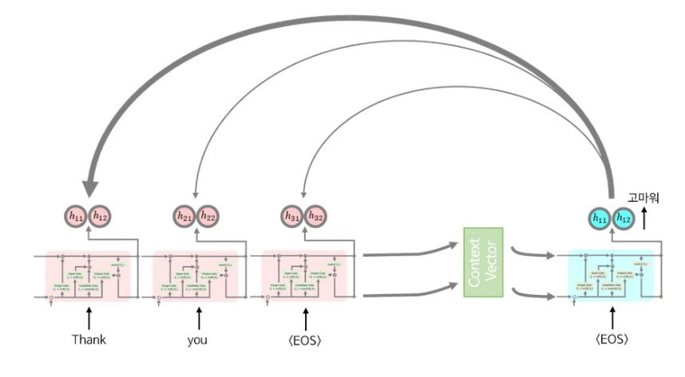
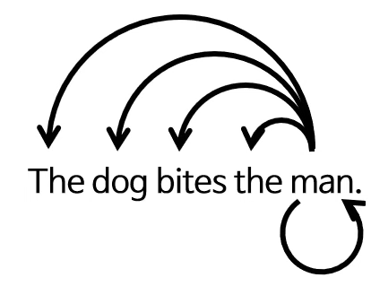
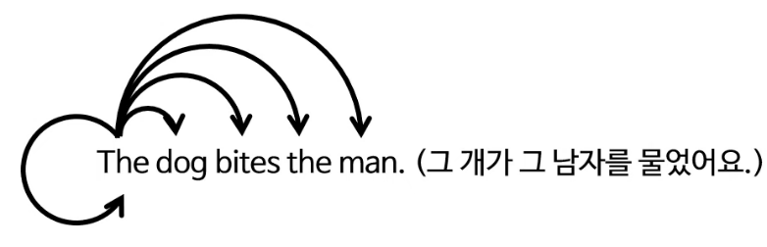
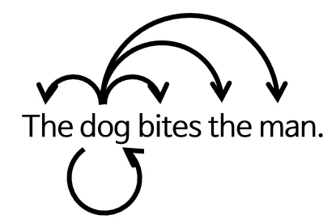


RNN
<attention mechanism> - Transformer
Multi Head Attention
Seq2Seq
Transformer

Slide 38


RNN
<attention mechanism> - Transformer
Multi Head Attention

Slide 39

RNN
<attention mechanism> - Transformer
Multi Head Attention

Slide 40



RNN
<attention mechanism> - Transformer
Multi Head Attention
$$W_{q,k,v}, d_{model}/h$$

Slide 41







RNN
<attention mechanism> - Transformer
Multi Head Attention

Slide 42




RNN
<attention mechanism> - Transformer
Mask(opt)

Slide 43
RNN
<attention mechanism> - Transformer
Multi Head Attention

Slide 44

RNN
<attention mechanism> - Transformer

